Slide 1

Case Studies & Guesstimates for FinTech Industries
Mohd Rihan Khan
Sanjay Ishwar DALAWAI
Mokhit Mahebub Khan
Abhijit Kumar
Yogesh Kumar saini

Slide 2
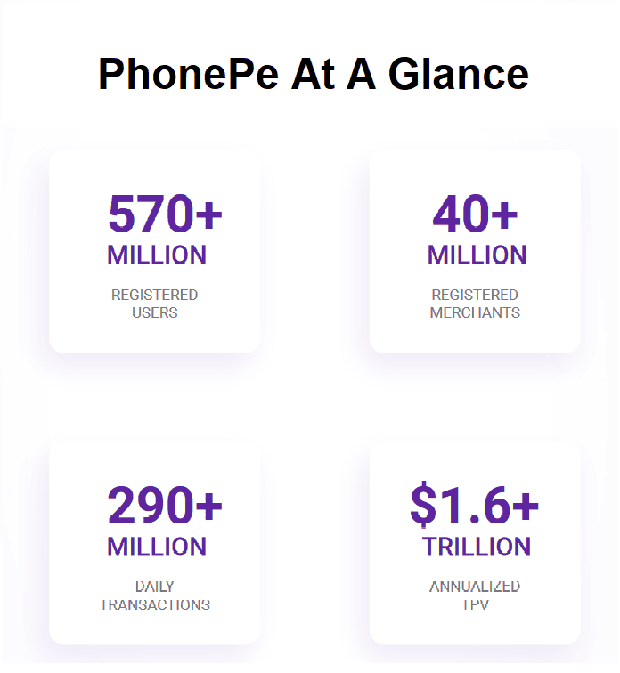
Part I: Product Dissection Of PhonePe
Introduction to PhonePe:
Leading digital payments platform in India.
Over 500 million registered users.
Supports UPI, bill payments, investments, and more.
Focus on financial inclusion and digital transactions.

Slide 3

FinTech Industry & PhonePe’s Role:
FinTech industry transforming traditional banking
Digital payments growing exponentially in India
PhonePe’s role in enabling cashless transactions
Expansion into financial services like insurance, lending, and investments

Slide 4
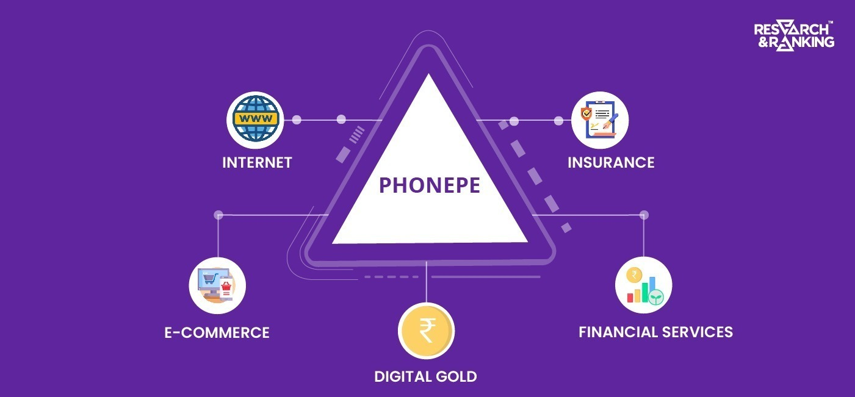
Product Dissection – Core Features:
UPI-Based Payments – Instant, secure, and free transactions
Merchant Payments – QR-based and integrated with e-commerce
Bill Payments & Recharges – Single platform for utility bills
Investments & Wealth Management – Mutual funds, gold, FDs
Insurance Services – AI-driven risk assessment for policies
Fraud Detection & Security – AI-powered transaction monitoring

Slide 5
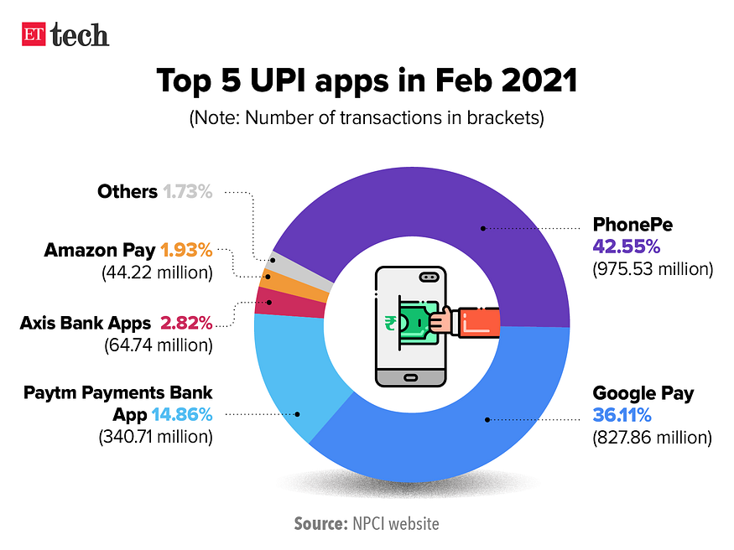
Impact & Relevance:
Financial Inclusion: Expanding digital payments to rural areas
Economic Growth: Supporting SMEs and businesses with cashless payments
Government Initiatives: Aligns with Digital India and UPI expansion
User-Centric Approach: Multi-language support and intuitive UI

Slide 6
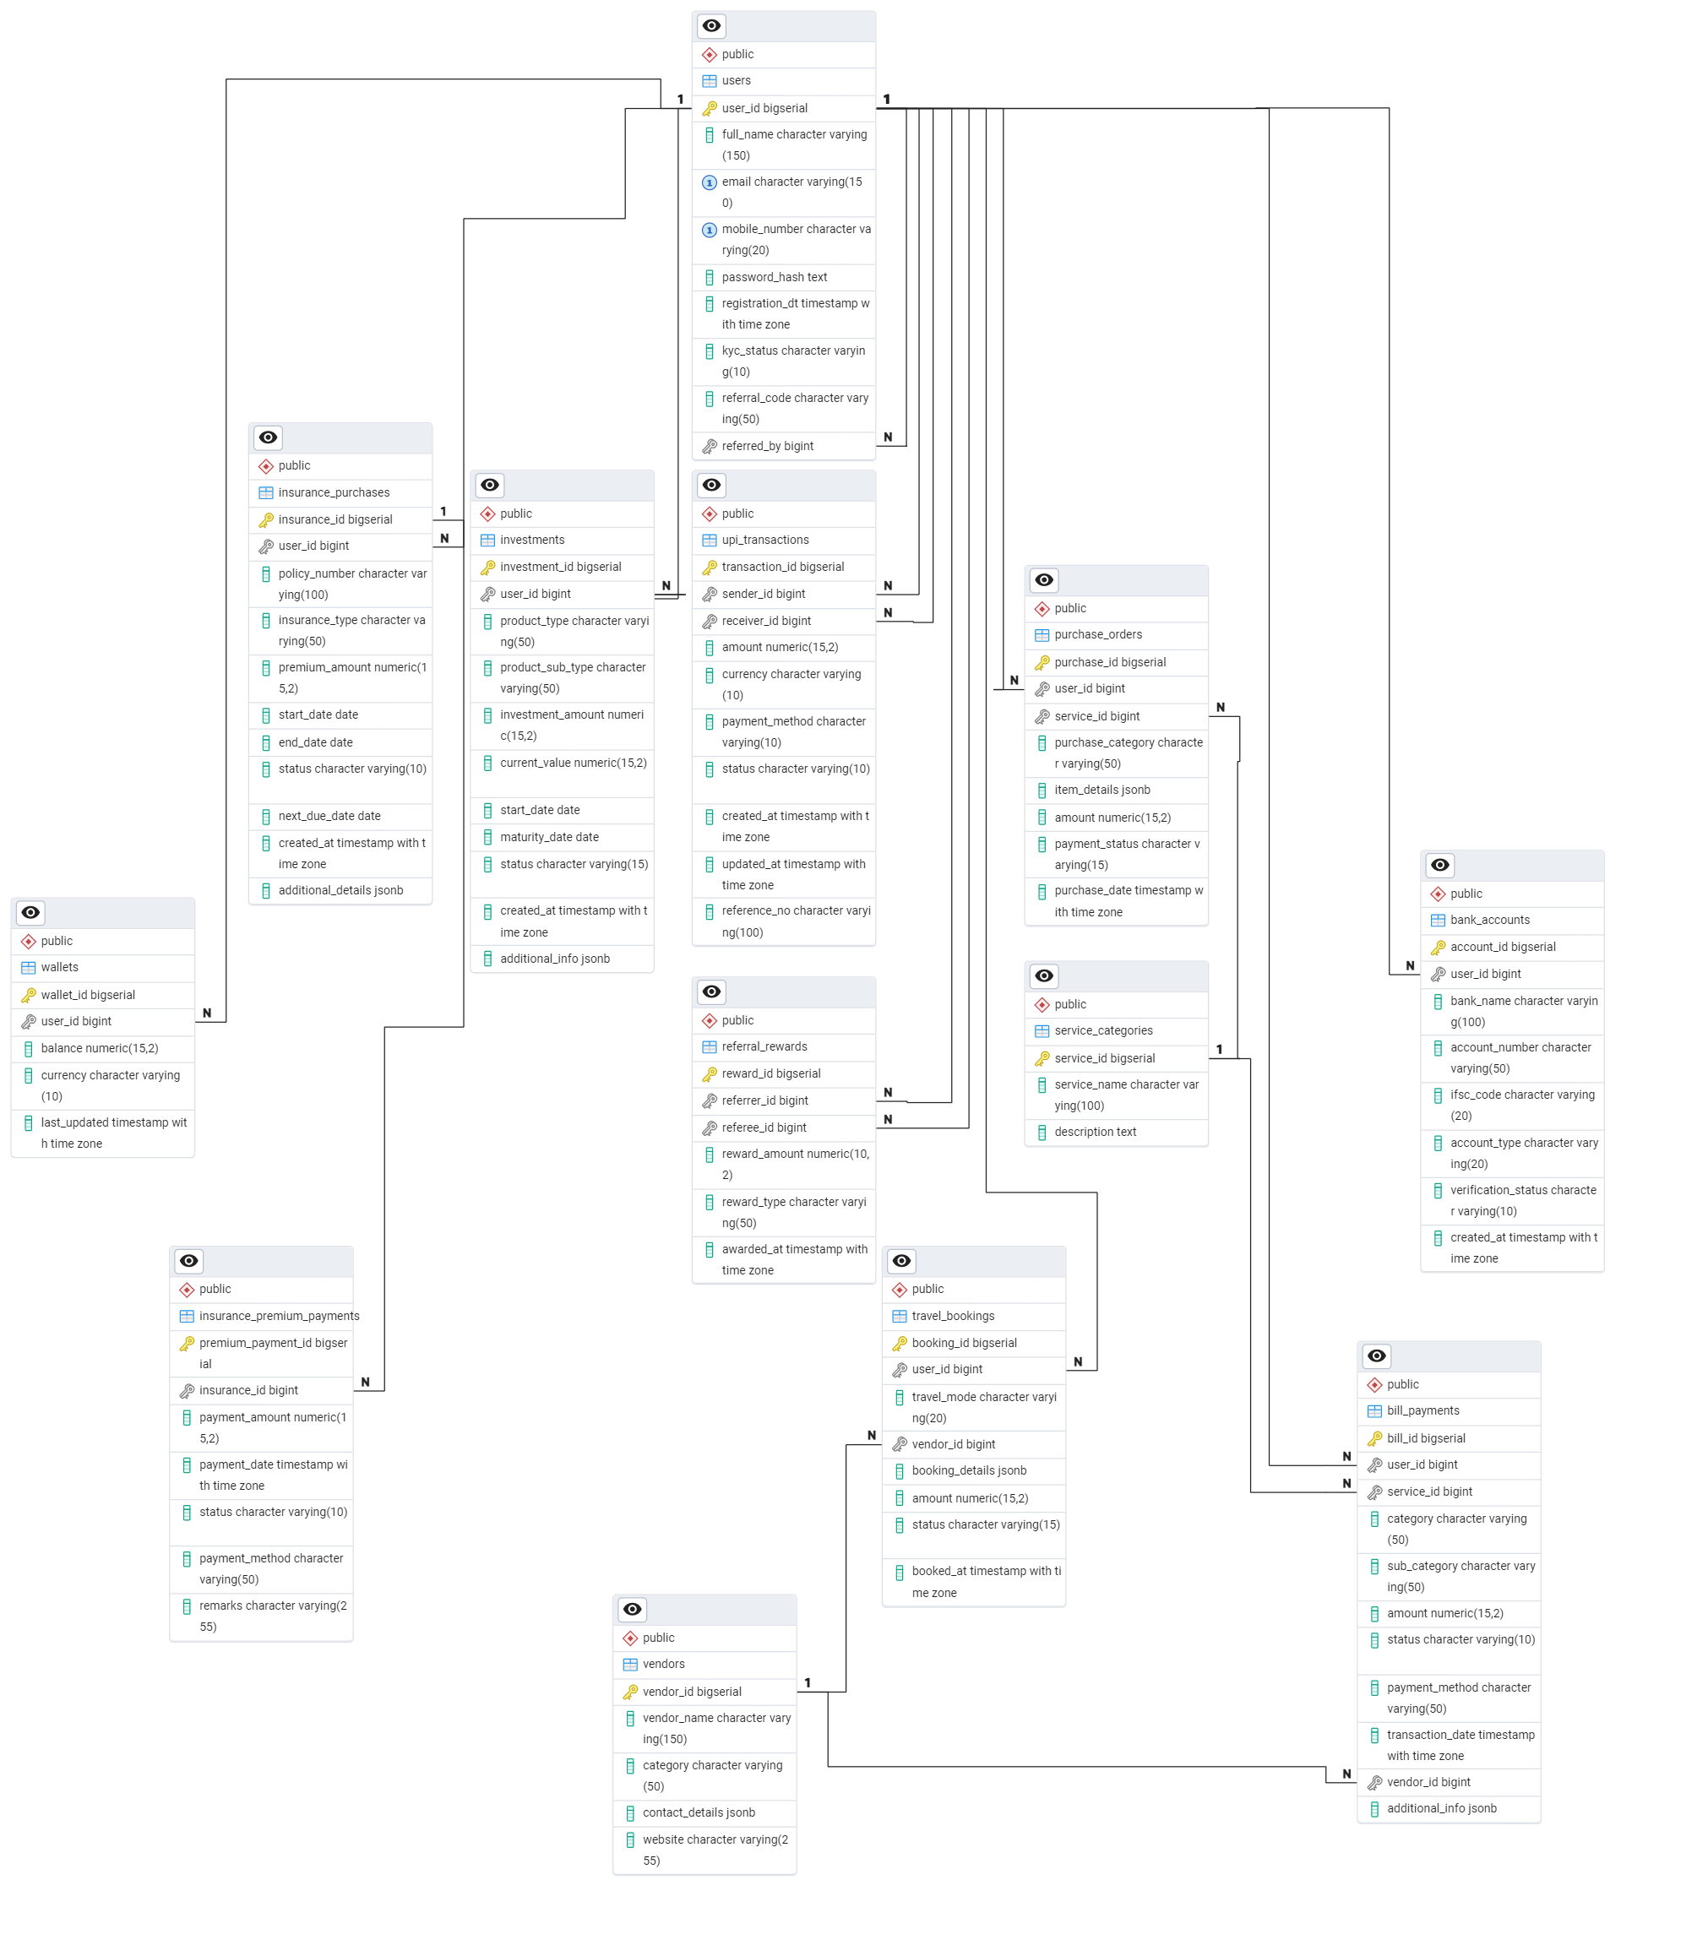
Schema Design & ER Diagram:
Key Entities: Users, Transactions, Wallets, Bill, UPI, Loans, Investments, etc.
Database Relationships: One-to-many (users & transactions), many-to-many (merchants & payments)

Slide 7
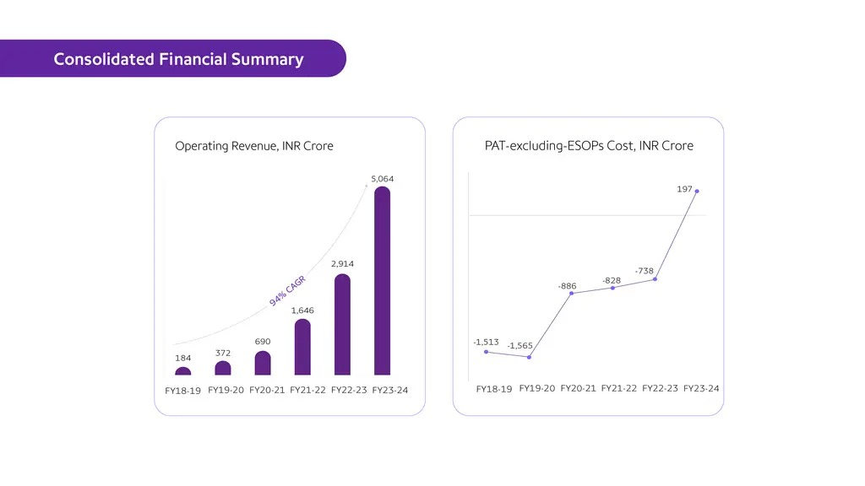
Revenue Sources:
UPI Merchant Discount Rate (MDR): 30% revenue
Bill Payments & Recharges: 10% revenue
Financial Services (Investments & Insurance): 20% revenue
Payment Gateway Services: 15% revenue
Lending & Buy Now, Pay Later (BNPL): 10% revenue
Advertising & Partnerships: 5% revenue
Offline Merchant Solutions & Cross-Border Payments: 10% combined revenue

Slide 8
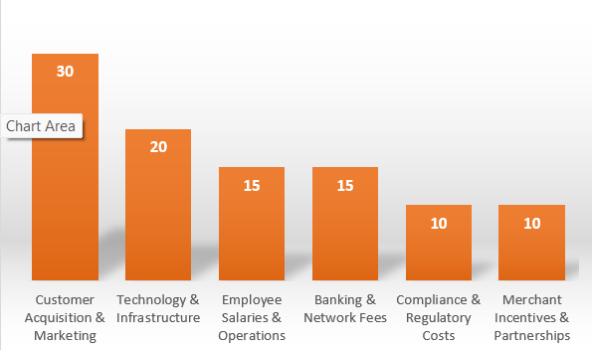
Expense Breakdown:
Customer Acquisition & Marketing: 30%
Technology & Infrastructure: 20%
Employee Salaries & Operations: 15%
Banking & Network Fees: 15%
Compliance & Regulatory Costs: 10%
Merchant Incentives & Partnerships: 10%

Slide 9

Strategy for 25% Profit Growth:
Internal Efficiency:
Cost Optimization: Reduce cloud/server expenses
AI Automation: Automate customer support & fraud detection
Product Innovation:
Expand micro-lending and investment options
Improve UI/UX for better engagement
Market Expansion:
Target tier-2 and tier-3 cities
Expand international cross-border payments
Customer Engagement & Branding:
Loyalty Programs & referral incentives
Financial Literacy Campaigns to build trust

Slide 10
Part II : Guestimates

Slide 11
What will be the percentage increase in global FinTech investments over the next five years?
This question involves estimating the growth rate of investments in FinTech startups and companies, considering current trends and future projections.
Solution:
Step 1: Current Global FinTech Investments
In 2024, global FinTech investments amounted to approximately $52 billion annually.
Step 2: Annual Growth Rate
Estimate an annual growth rate for global FinTech investments.
Assume an 8% annual growth rate (based on current trends).
Step 3: Project Future Investments After 5 Years
Use the formula for compound growth:
Future Value = Current Value×(1+Growth Rate)^n
Where:
Current Value = $52 billion
Growth Rate = 8% = 0.08
n = 5 years
Future Value = 52 × (1+0.08)^5 = 52 × 1.46933 = $77 billion
Step 4: Calculate the Percentage Increase
Percentage Increase =( Future Value − Current Value / Current Value)×100
Percentage Increase = (77 − 52 / 52) ​× 100
= ~ 50 %
Final Answer: Based on an 8% annual growth rate, global FinTech investments are projected to grow to approximately $77 billion in five years, representing a 50% increase.

Slide 12
2. How many people will adopt digital banking services in developing countries over the next decade?
This question requires an estimation of the number of new users of digital banking solutions in regions where traditional banking infrastructure is less prevalent.
1. Population in Developing Countries
Current population of developing countries: ~5 billion (based on global estimates).
Expected annual population growth rate: 1%.
Population after 10 years:
Future Population = Current Population×(1+Growth Rate)^n
Future Population = 5×(1+0.01)^10= 5.523 ≈ 5.6 billion
2. Internet Penetration
Current internet penetration in developing countries: 50% (source: World Bank).
The expected annual growth rate of internet penetration: 5%.
Internet penetration after 10 years:
Future Penetration=Current Penetration×(1+Growth Rate)^n
Future Penetration = 0.50 (1 + 0.05)^{10} = 0.814
Total internet users after 10 years:
Internet Users = Future Population×Future Penetration
= 5.6×0.814
= 4.558
≈ 4.6 billion.
3. Adoption Rate of Digital Banking
Assume 60% of internet users in developing countries will adopt digital banking services over the next decade (due to increased smartphone use and fintech solutions).
Total digital banking users:
Digital Banking Users = Internet Users × Adoption Rate
Digital Banking Users = 4.6 × 0.60 = 2.76 ≈ 3 billion
Final Answer: Approximately 3 billion people in developing countries are estimated to adopt digital banking services over the next decade.

Slide 13
3. What percentage of small and medium-sized enterprises (SMEs) will use FinTech solutions for their financial needs by 2025?
This question involves predicting the adoption rate of FinTech services among SMEs, including payments, lending, and financial management tools.
Solution:
Current Trends:
In 2023, ~30% of SMEs globally use FinTech solutions (e.g., digital payments, lending platforms, accounting tools).
Adoption is higher in developed markets (e.g., 50% in the US) and lower in developing markets (e.g., 20% in Africa).
Assumptions:
Growth Rate: Adoption will grow at ~10% annually due to increased awareness, affordability, and regulatory support.
SME Population: There are ~400 million SMEs globally.
Drivers: Digital payments, working capital loans, and automated accounting tools will drive adoption.
Calculation:
Current Users: 30% of 400 million = 120 million SMEs.
Total Users by 2025 : 120*(1+0.1)^2 = 145.2 million SMEs.
Percentage Adoption:
Adoption Rate: (145.2 million / 400 million) × 100 = 36.3%.
Final Answer: By 2025, approximately 37% of SMEs globally will use FinTech solutions for their financial needs.

Slide 14
4. What will mobile payments' average transaction value in the next three years?
This question requires estimating the average amount of money transacted through mobile payment platforms, considering the growth of mobile commerce and digital wallets.
Solution:
Current Trends:
In 2024, the average transaction value for mobile payments is ~$50.
Growth is driven by increased adoption of mobile wallets, QR codes, and contactless payments.
Assumptions:
Growth Rate: The average transaction value will grow at ~5% annually due to inflation and higher adoption of premium services.
Drivers: E-commerce growth, higher disposable incomes, and increased use of mobile payments for larger transactions.
Calculation:
Year 1: 50×1.05=52.50
Year 2: 52.50×1.05=55.13
Year 3: 55.13×1.05=57.88
Final Answer: The average transaction value of mobile payments will increase to approximately $58 in the next three years.

Slide 15
5. How much will blockchain technology reduce the costs of cross-border transactions in the next five years?
This question involves estimating the cost savings achieved through adopting blockchain technology for international money transfers, factoring in current fees and the efficiency improvements blockchain brings.
Solution:
We will estimate the percentage reduction in costs for cross-border transactions due to blockchain adoption.
Step 1: Understanding the Current Costs of Cross-Border Transactions
Currently, traditional cross-border transactions incur the following fees:
Bank Processing Fees: ~2–2.5% per transaction
Intermediary Bank Charges: ~1–1.5%
Foreign Exchange Markup: ~1–1.5%
Other Miscellaneous Charges: ~1%
Total Cost for Traditional Cross-Border Transactions: ~6% of the transaction amount
Step 2: Estimating Blockchain-Based Cost Reduction
Blockchain-based solutions (e.g., Ripple (XRP), Stellar (XLM), and stablecoins (USDT, USDC)) significantly reduce costs by:
Eliminating intermediaries (0% intermediary bank fees)
Minimizing processing costs (as low as 0.1–1%)
Reducing forex markups (due to peer-to-peer exchange systems)
Estimated Cost for Blockchain Transactions: ~1.5% of the transaction amount
Assumption:
Adoption Rate: The projected Adoption Rate for the next 5 Years could be 40%, Adoption is increasing, but several factors (regulatory issues, trust, integration with banks, etc.) may slow it down.

Slide 16
Step 3: Blended Cost Reduction Calculation
We now calculate the average cost reduction, considering that blockchain-based transactions will make up only 40% of the market, while 60% will still use expensive traditional methods.
Weighted Average Cost in 2030 New Average Cost = (0.6*6%) + (0.4*1.5%)
= 3.6% + 0.6%
= 4.2% (blended cost)
Percentage Reduction Compared to Today (5% average cost):
(6% - 4.2%)
-------------- * 100 = 30%
6%
Final Answer: By 2030, blockchain could reduce the average cost of cross-border transactions by approximately 30%, considering that only ~40% of transactions will shift to blockchain.

Slide 17
Part III Scenario Based Question

Slide 18
Scenario 1
Question 1: Cohort Analysis – User Retention
Cohort Analysis for Monthly Retention Rate
A cohort analysis was conducted to understand user retention trends over the past six months by tracking users’ activity based on their signup month.
Key Findings:
🔹 Major Drop-off After Month 1 🔹 Retention Stabilizes in Later Months
Proposed Strategies for Improvement:
✅ Improve Onboarding Experience
✅ Engage Users with Personalization
✅ Loyalty Programs ✅ Feature Enhancements
Expected Impact:
Enhanced user retention, engagement, and long-term transaction activity, leading to sustained growth and profitability.

Slide 19
Q. 2: Addressing the Significant Drop in Retention After Month 1
The cohort analysis revealed that the biggest drop-off occurs between Month 0 and Month 1, indicating that many users sign up but do not return after their first transaction.
Key Reasons for Drop-Off:
🔹 Poor Onboarding Experience 🔹 Lack of Engagement & Incentives 🔹 Security & Trust Concerns 🔹 Competition from Other FinTech Apps 🔹 Technical Issues
Proposed Strategies for Retention Improvement:
✅ Enhance User Onboarding ✅ Boost Engagement with Notifications & Gamification ✅ Offer Incentives ✅ Build Trust & Security Awareness
✅ Optimize App Performance
Expected Impact:
By implementing these strategies, the company can reduce drop-offs, improve user retention, and drive long-term engagement, leading to sustained growth and profitability.

Slide 20
Scenario 2
Q. 1: A/B Testing – Loan Approval Notification An experiment was conducted to determine the most effective loan approval notification for increasing loan acceptance rates.
Version A: Simple approval message.
Version B: Detailed loan breakdown with repayment options.
🔹 Result: Version B led to a 10% increase in loan acceptance due to better transparency and clarity. 🔹 Action: Implement Version B as the standard notification format to improve conversion rates.
Expected Impact: Higher loan approvals, improved user confidence, and better engagement in financial services.

Slide 21
Q.2: Evaluating the Justification for Version B Implementation
An A/B test showed that Version B (detailed loan notification) increases loan acceptance by 10%, generating $2.4 million in annual revenue but requiring $50,000 in implementation costs. A cost-benefit analysis was conducted to assess feasibility.
1️⃣ Revenue Impact
🔹 Higher Loan Acceptance – 200 additional loans per month. 🔹 Incremental Annual Revenue – $2.4 million from extra interest.
2️⃣ Cost-Benefit Analysis
🔹 Implementation Cost – $50,000 (one-time). 🔹 Minimal Additional Support Costs – No major impact. 🔹 Net Benefit – $2.35 million annually.
3️⃣ Additional Considerations
✅ Break-even Analysis – Justifying the cost with increased acceptance. ✅ Long-Term Impact – Potential retention benefits. ✅ Regulatory Compliance – Ensuring adherence to financial rules. ✅ Risk Assessment – Monitoring default rates.
Final Recommendation
If default rates remain stable, Version B should be implemented, with continuous monitoring to ensure profitability and compliance.

